Slide 1

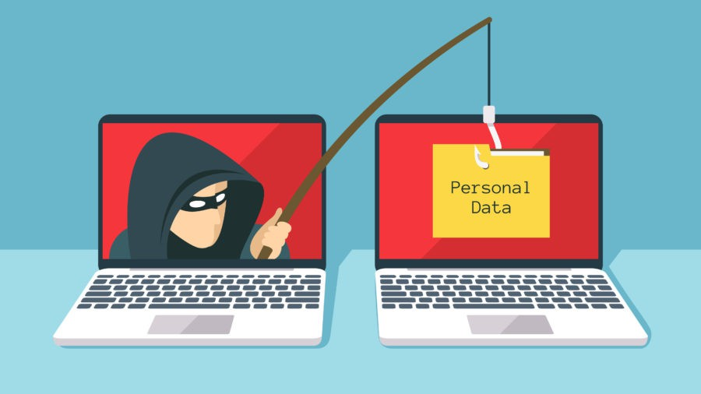
PHISHING IN DEPTH
(ATTACKS & MITIGATIONS)

Slide 2

Table of Content
1.0 Introduction
2.0 Phishing
3.0 Phishing kit
4.0 Types of Phishing
5.0 Avoidance Techniques
6.0 Effect of Phishing on Businesses
7.0 Demos & Practical

Slide 3

INTRODUCTION
ERIC NII SOWAH BADGER (NiiHack)
Software Developer / Certified Ethical Hacker
Penetration Tester / CTF Player on HackTheBox
Member of Inveteck Global
LinkedIn: Eric Nii Sowah Badger
INSTAGRAM: ni1hack
TWITTER: ens_nii

Slide 4


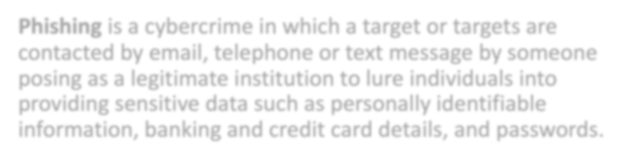
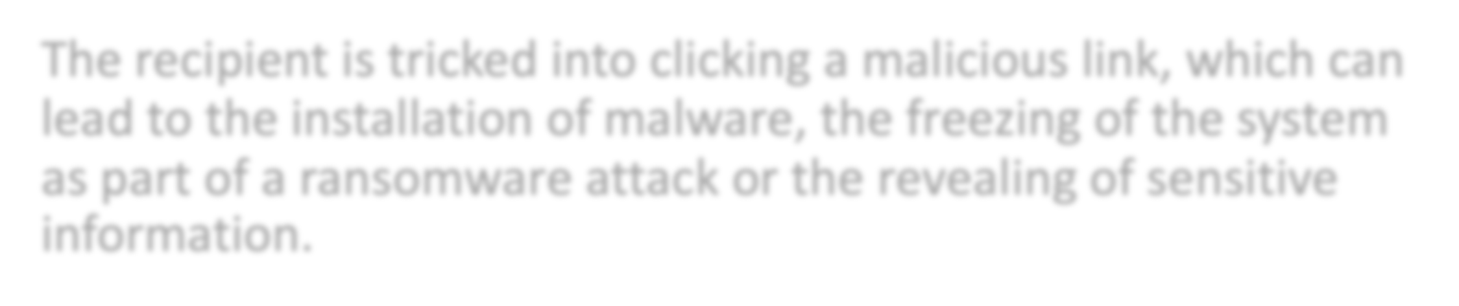


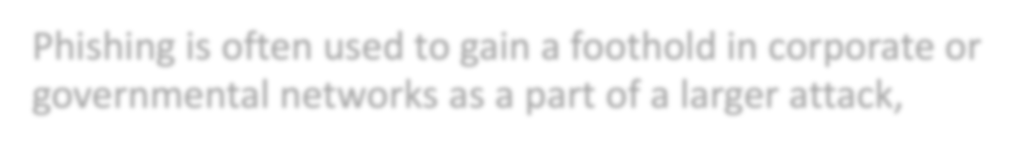

PHISHING
Phishing is a cybercrime in which a target or targets are contacted by email, telephone or text message by someone posing as a legitimate institution to lure individuals into providing sensitive data such as personally identifiable information, banking and credit card details, and passwords.
The recipient is tricked into clicking a malicious link, which can lead to the installation of malware, the freezing of the system as part of a ransomware attack or the revealing of sensitive information.
Phishing is often used to gain a foothold in corporate or governmental networks as a part of a larger attack,

Slide 5

What kind data do criminals want from victims?
Credit card details, account numbers and PINS
Social security numbers
Username and passwords
Birthdays and anniversaries
Passport numbers

Slide 6
PHISHING KIT
A phishing kit is the web component, or the back-end to a phishing attack.
It's the final step in most cases, where the criminal has replicated a known brand or organization.
Once loaded, the kit is designed to mirror legitimate websites, such as those maintained by Microsoft, Apple or Google.

Slide 7
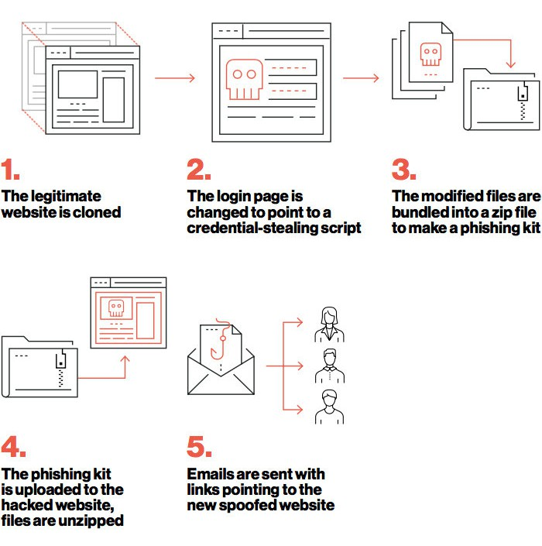
ANATOMY OF A PHISHING KIT
STEPS IN CREATING A PHISHING KIT

Slide 8
TYPES OF PHISHING
EMAIL PHISHING
Usually appear to come from a well-known organization and ask for your personal information — such as credit card number, social security number, account number or password
1
SMISHING
When someone tries to trick you into
giving them your private information
via a text or SMS message
2
VISHING
is the telephone equivalent of phishing. It is described as the act of using the telephone in an attempt to scam the user
into surrendering private information that will be used for identity theft.
WHALING
3
SPEAR PHISHING
The fraudulent practice of sending emails
ostensibly from a known or trusted
sender in order to induce targeted individuals to reveal confidential information
4
A method to masquerade as a senior player at an
5
organization and directly target senior or other important individuals at an organization, with the aim of stealing money or sensitive information or gaining access to their computer systems for criminal purposes.

Slide 9
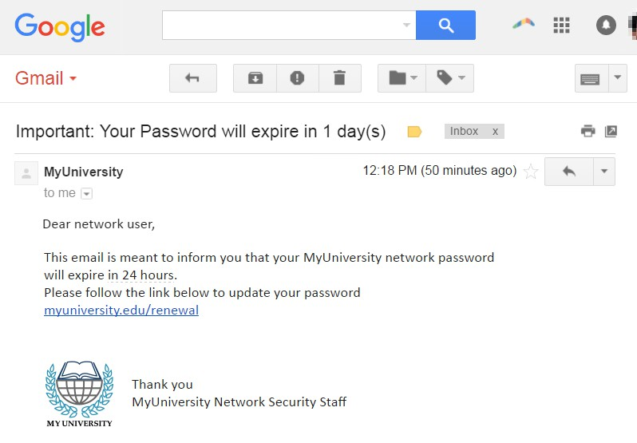
EMAIL PHISHING
SAMPLE EMAIL PHISHING TO HAVEST PASSWORDS

Slide 10
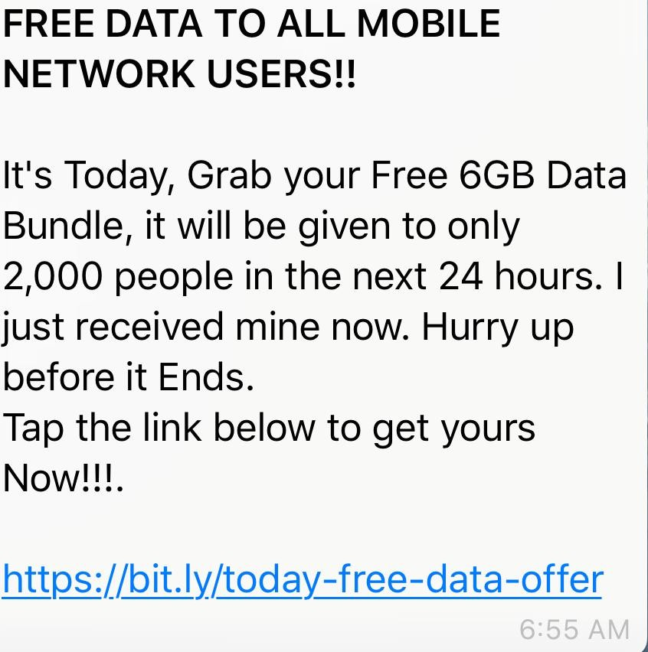

SMISHING PHISHING
SAMPLE SMISHING MESSAGE TO HARVEST PERSONAL INFO

Slide 11
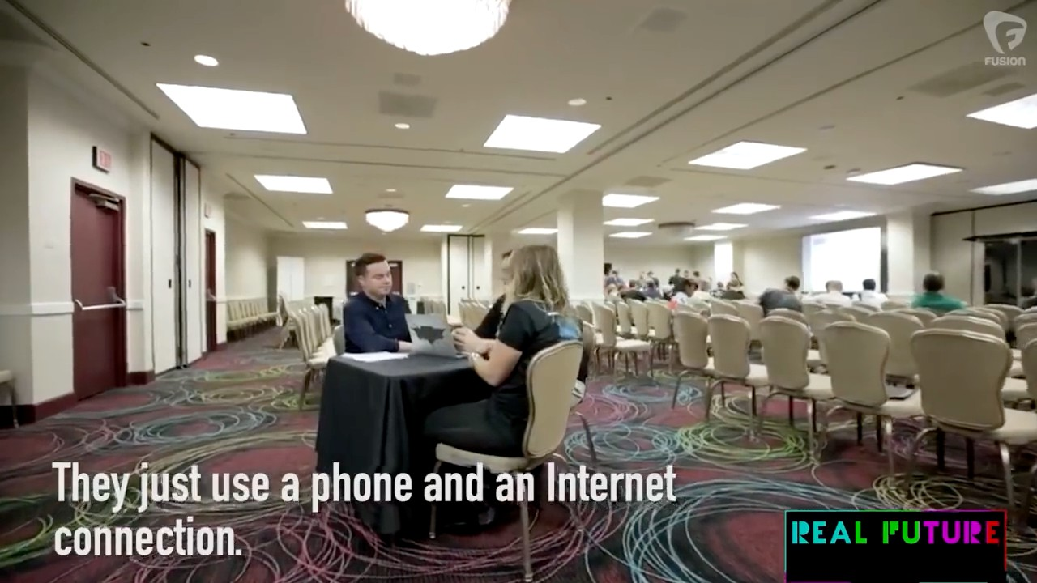
VISHING
VIDEO DEMO OF A VISHING ATTACK TO GET SENSITIVE INFO

Slide 12
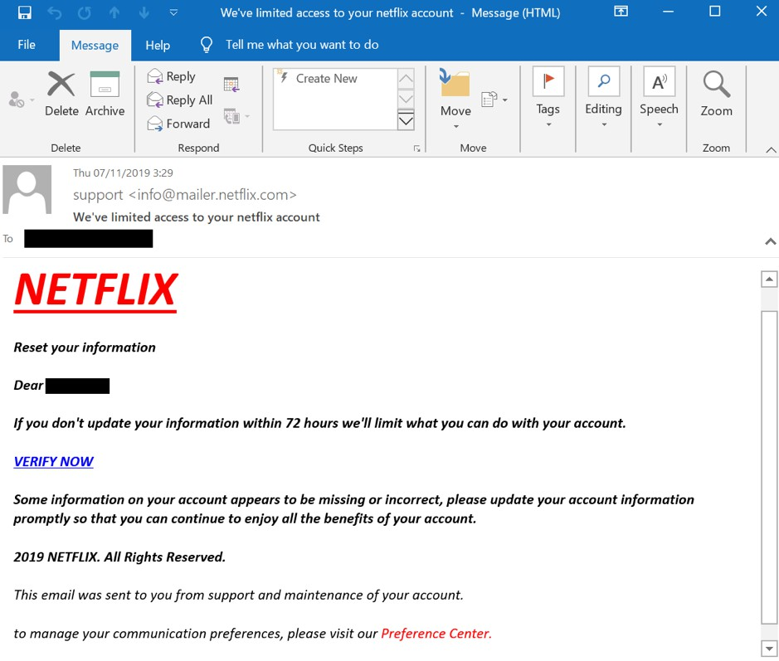
SPEAR PHISHING
SAMPLE SPEAR PHISHING MESSAGE TARGETED AT A NETFLIX USER

Slide 13
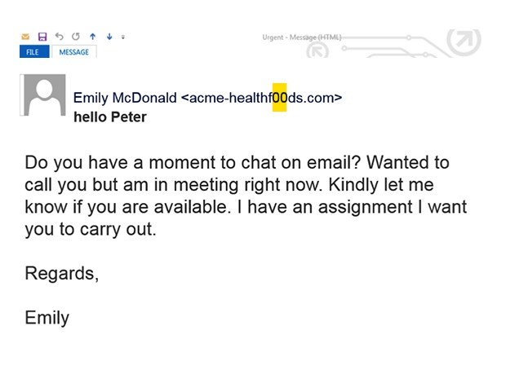
WHALING
SAMPLE WHALING MESSAGE TO GET PERSONAL INFO

Slide 14

AVOIDANCE TECHNIQUES
Always, Always Think Twice Before Clicking
Two Factor Authentication (2FA)
Don’t click on links, type them directly in the URL
Verify link first before clicking
(www.virustotal.com)
Hover mouse on link to be sure its legit before clicking
EMAIL PHISHING
PHISHING

Slide 15

AVOIDANCE TECHNIQUES
Always, Always Think Twice Before Clicking (There is no free lunch)
Avoid clicking on any UNKNOWN messages with links
Verify links if there are malicious(contains
malwares or viruses) first before clicking (www.virustotal.com)
Ignore and flags suspicious texts
Do extensive research before replying to any message.
SMISHING
PHISHING

Slide 16
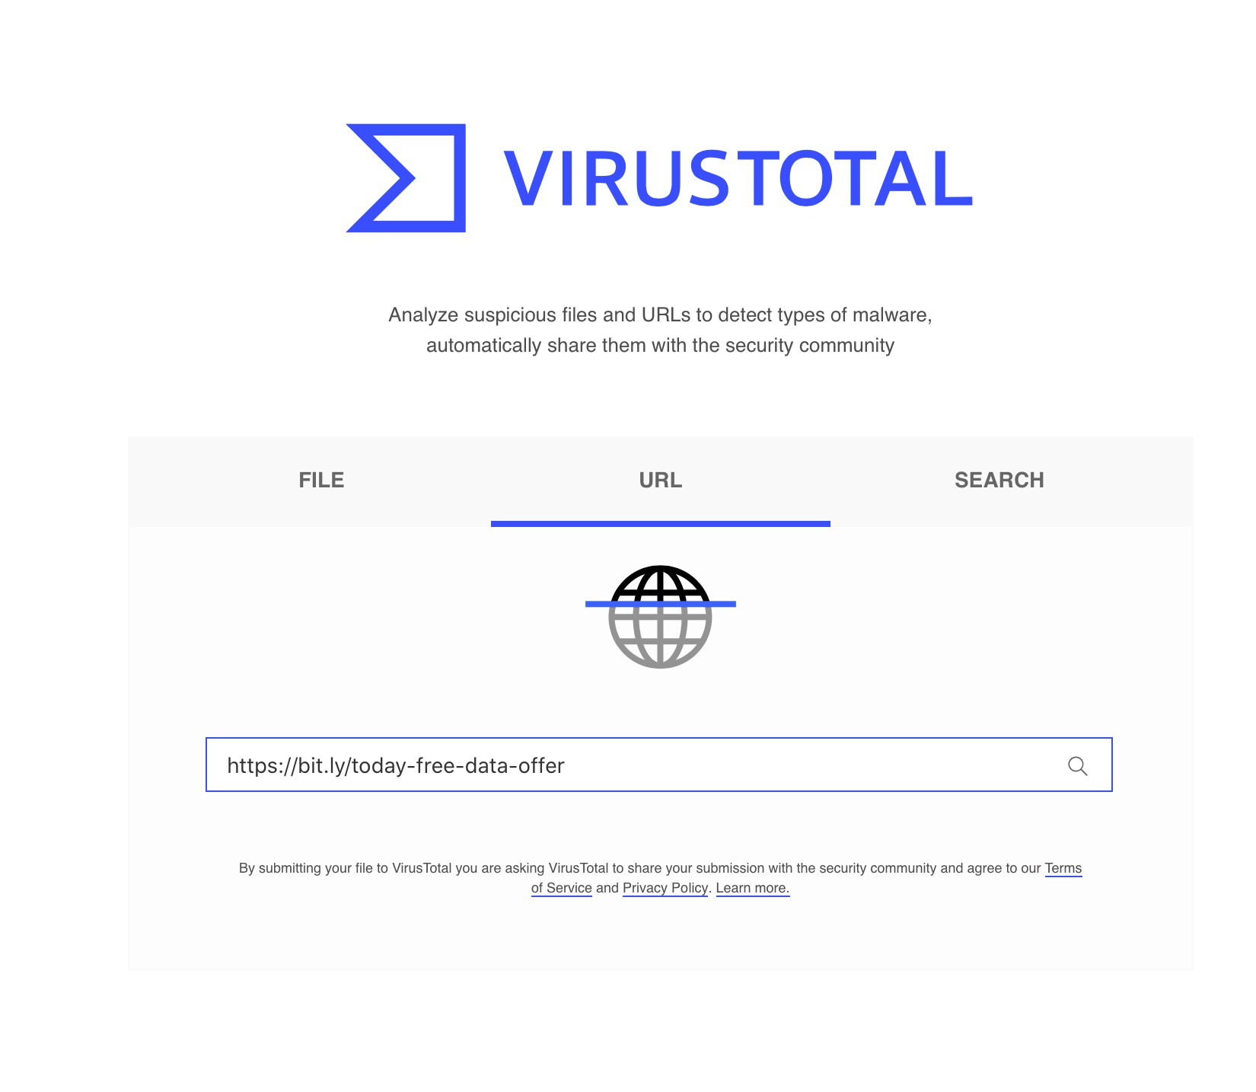
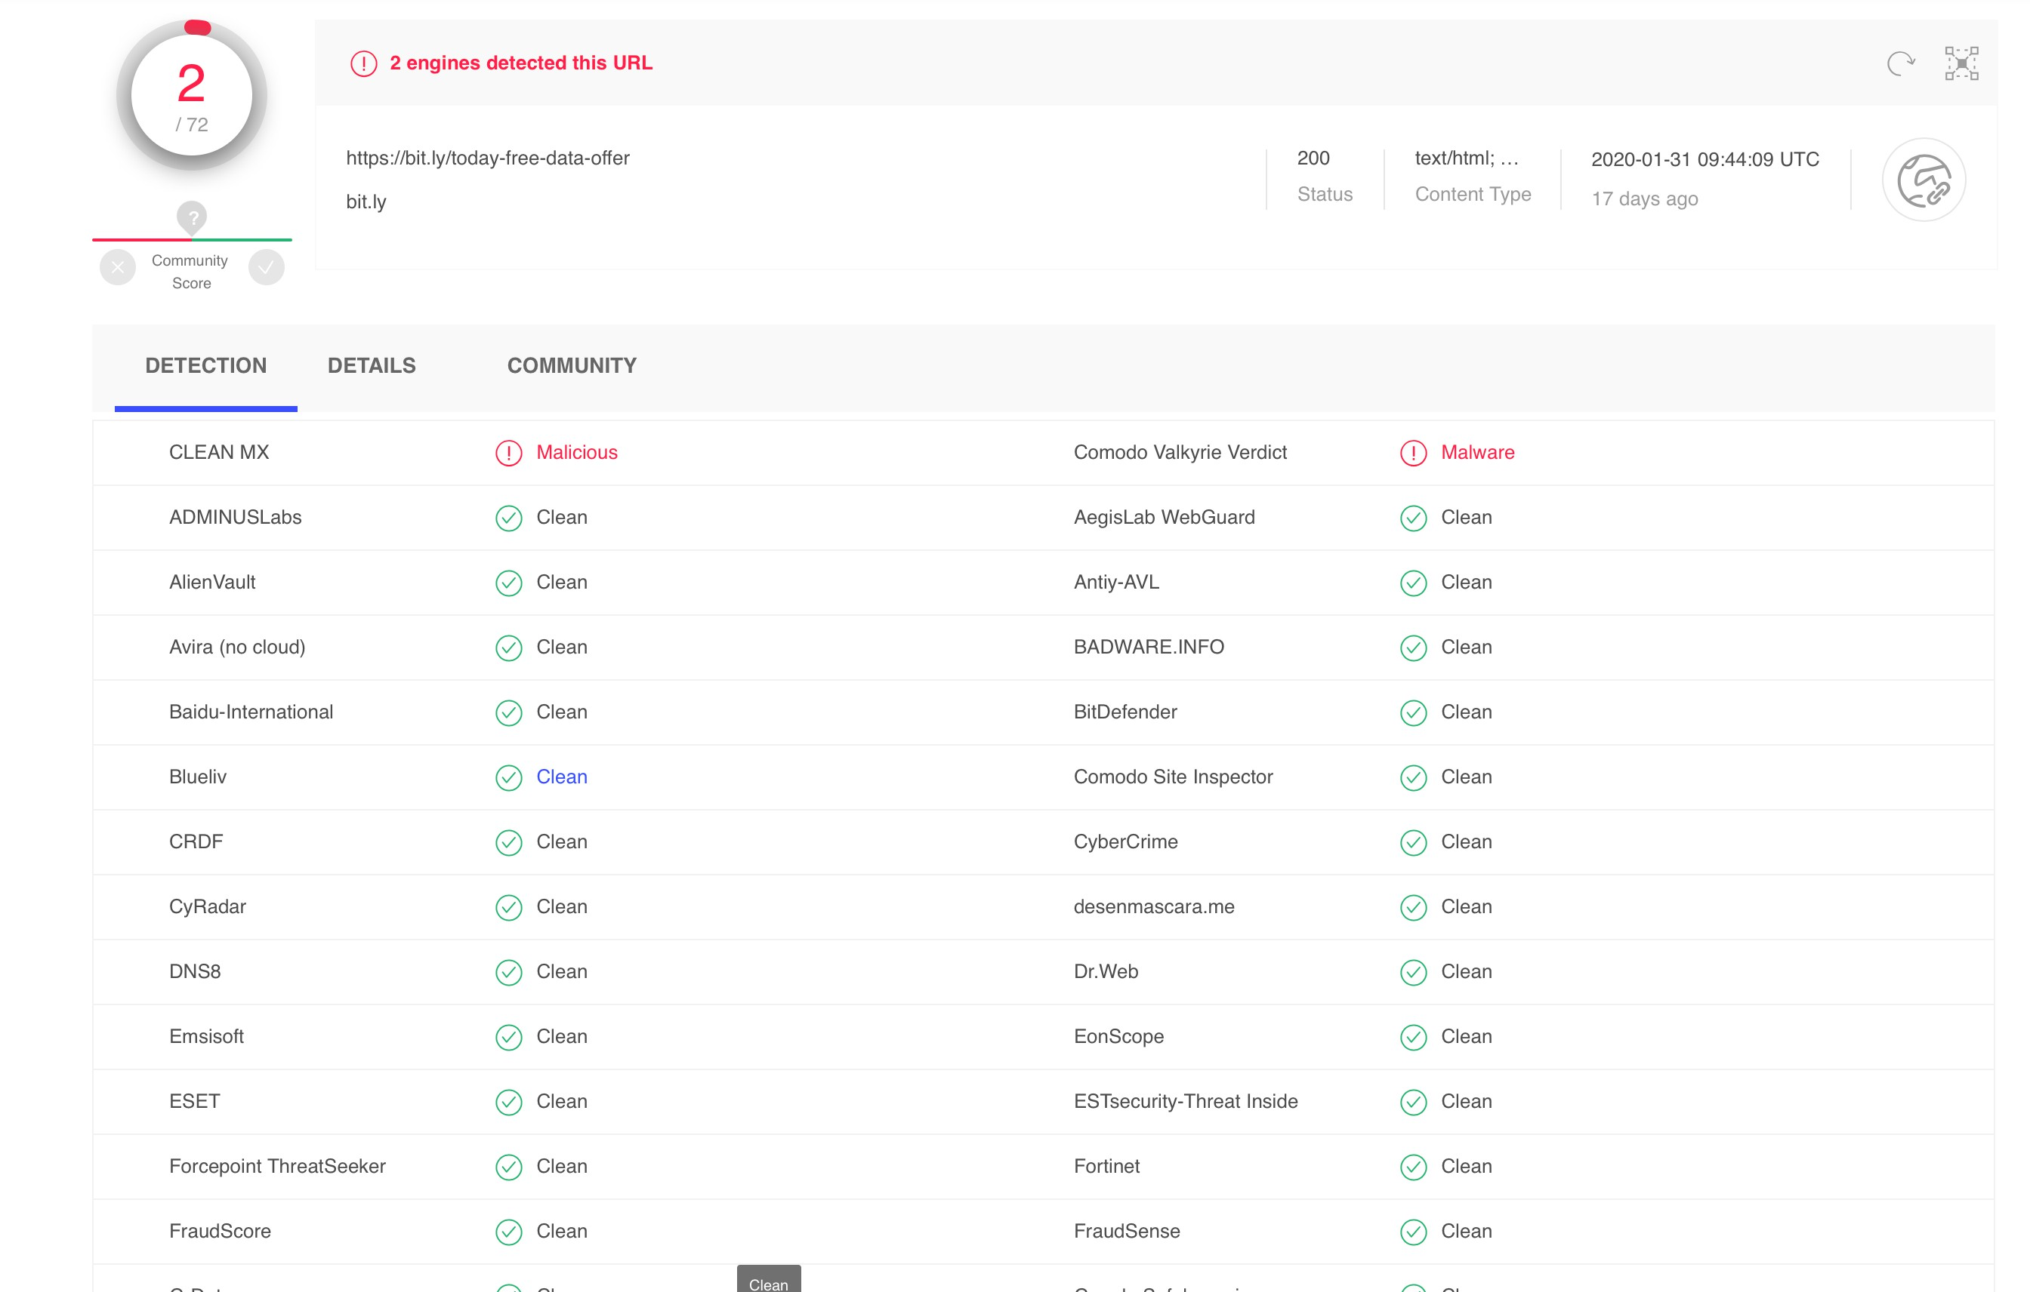


AVOIDANCE TECHNIQUES
SMISHING
PHISHING
HOW TO USE VIRUSTOTAL TO VERIFY LINKS FOR MALWARES AND OTHER MALICIOUS CODES BEFORE CLICKING ON THEM WWW.VIRUSTOTAL.COM

Slide 17

AVOIDANCE TECHNIQUES
Be very suspicious of any caller who asks you to share login information over the phone.
If a caller asks you to provide account data or personally identifiable information, refuse to do so
Security won’t call you to request that
PHISHING
VISHING
you change logins, passwords, or network settings.
Always do a 2nd Verification of suspicious
calls

Slide 18

AVOIDANCE TECHNIQUES
Don’t be swayed just because a correspondent
seems to know a lot about you
Don’t rush to send out data just because the other person tells you it’s urgent
Don’t be afraid to get a second opinion
Verify and validate
Trust no one
PHISHING
SPEAR PHISHING

Slide 19

AVOIDANCE TECHNIQUES
Use two-factor authentication for email to avoid accounts becoming compromised.
Establish a verification process for transferring funds, such as face-to-face verification or verification over the phone.
Utilize an email filtering system for inbound emails that flags emails sent from similar-looking domain names.
Use mock whaling attacks against employees to teach them how easy it is to be tricked.
Enforce strict Passwords policies
WHALING
PHISHING

Slide 20
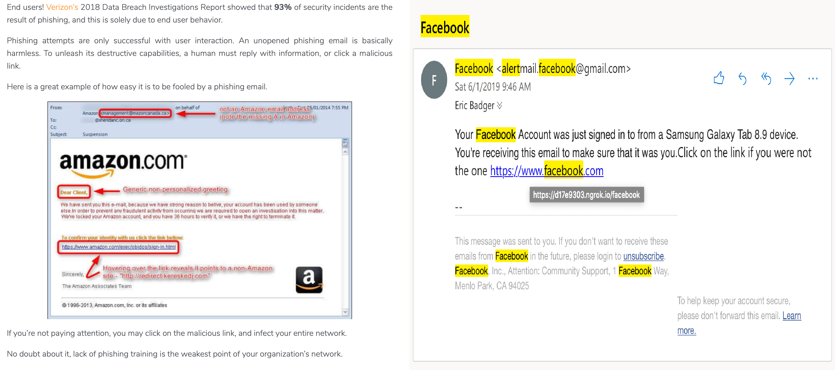
AVOIDANCE TECHNIQUES
HOW TO DETECT PHISHING EMAIL

Slide 21
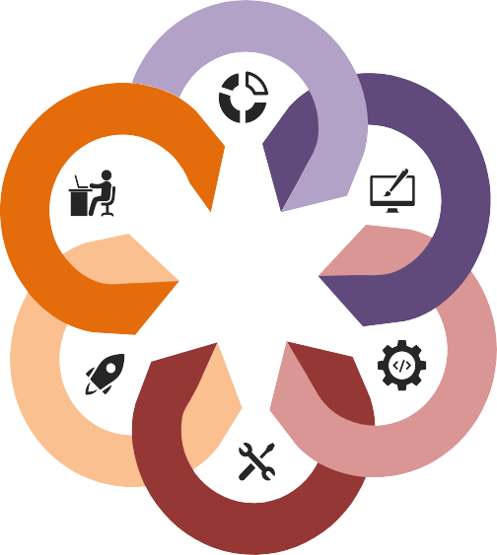

EFFECTS OF PHISHING ON BUSINESSES
1. Reputational Damage
Headlines like “British Airways data breach: Russian hackers sell 245,000 credit card details” and “Uber concealed massive hack that exposed data of 57m users and drivers”.
2. Loss of customers
After 157,000 of TalkTalk’s customers had their data compromised in 2015, customers left in their thousands. The company’s eventual financials revealed the true costs of the breach to be around £60m in 2016 alone.
6. Safeguarding against phishing
Phishing filters can help but, unfortunately, no phishing
filter is 100% effective.
Phishing Effects
3. Loss of company value
Following the compromise of Facebook user data in 2018, Facebook’s valuation dropped by $36bn – a loss from which (at the time of writing) the company is yet to fully recover. In public companies, the pattern is clear: following a breach, company value decreases.
5. Business disruption
After being infected by malware in 2017 (most likely following a phishing email), the advertising multinational WPP instructed its 130,000 employees to “immediately turn off and disconnect all Windows servers, PCs and laptops until further notice.”
4. Regulatory fines
Financial penalties for the misuse or mishandling of data have been in place for decades. Under GDPR, the penalties can total €20 million or 4% of a company’s annual global turnover – whichever is higher.

Slide 22
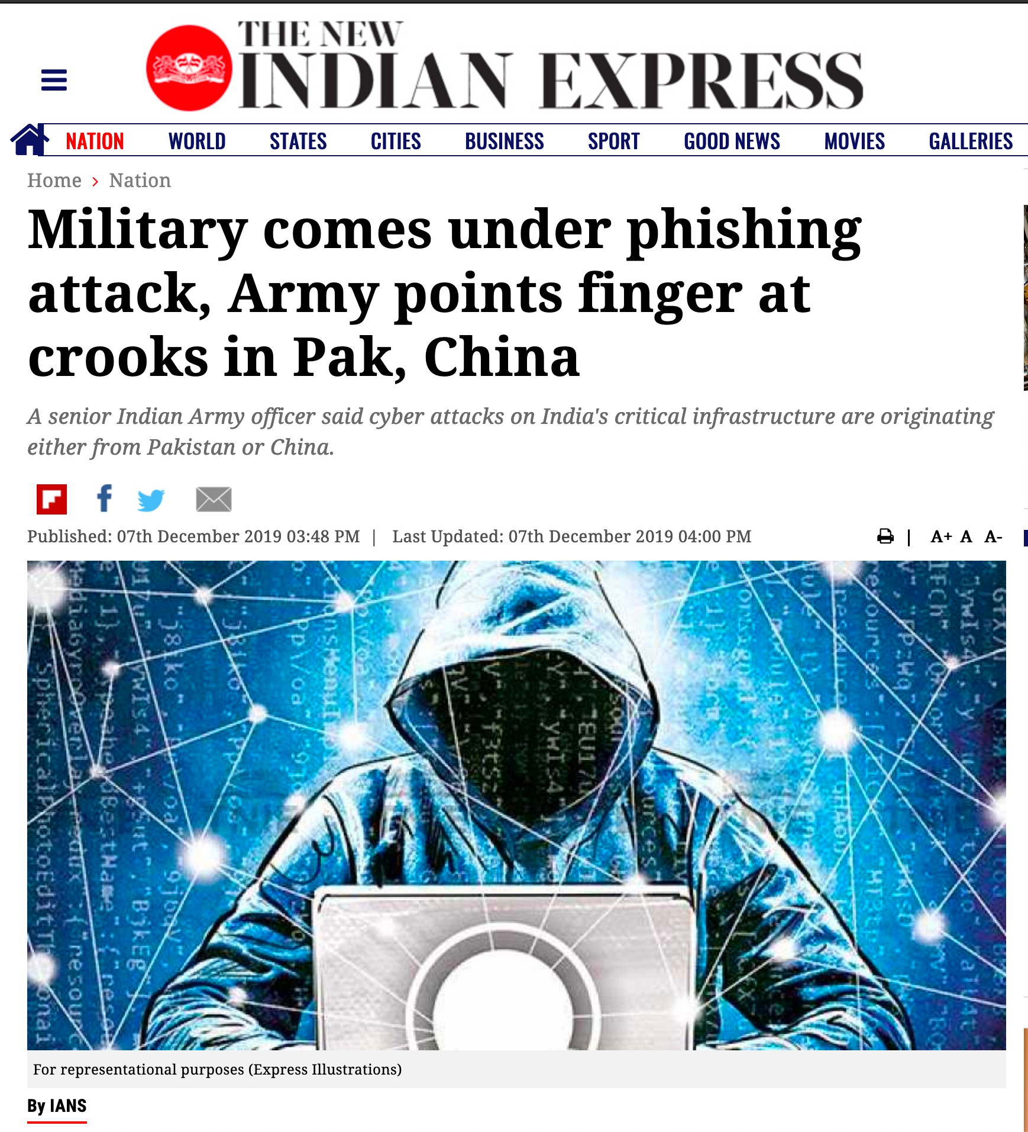
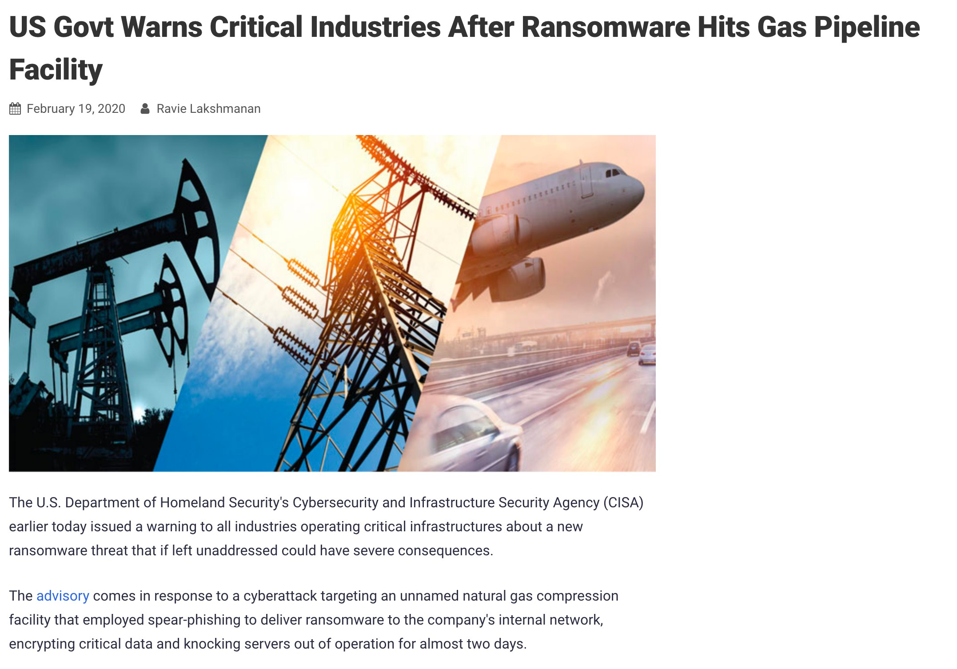
SPEAR-PHISHING ATTACK USED TO DELIVER RANSOMWARE TO A COMPANY’S INTERNAL NETWORK
EFFECTS OF PHISHING ON INDIAN ARMY

Slide 23
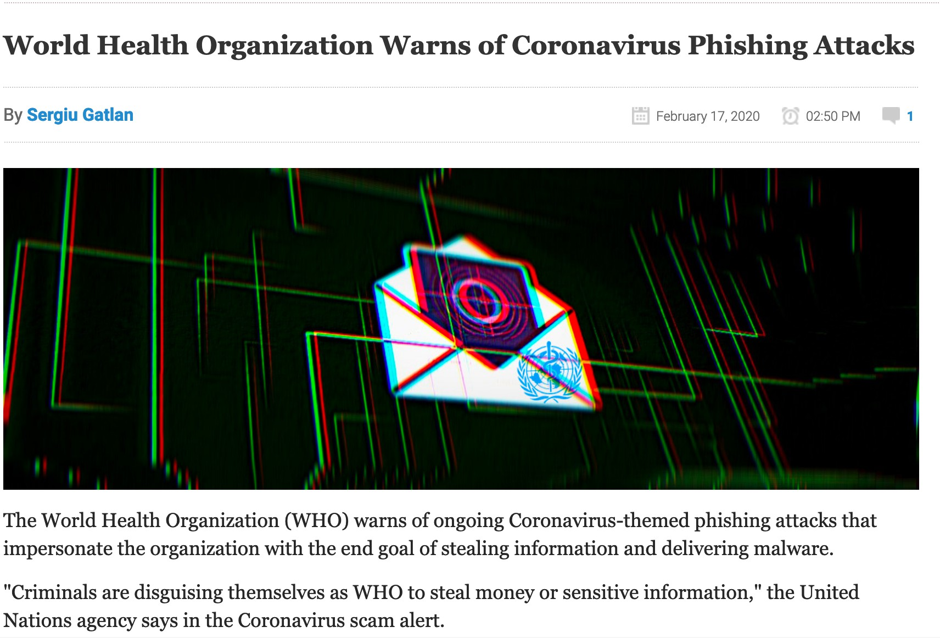
WORLD HEALTH ORGANIZATION WARNS OF CORONAVIRUS PHISHING ATTACKS

Slide 24
DEMOS & PRACTICALS

Slide 25
REFERENCES
https://www.imperva.com/learn/application-security/phishing-attack-scam/
https://digitalguardian.com/blog/what-is-spear-phishing-defining-and- differentiating-spear-phishing-and-phishing
https://www.mimecast.com/blog/2018/10/4-simple-tips-for-stopping-vishing/
https://www.ntiva.com/blog/how-phishing-affects-businesses
https://www.newindianexpress.com/nation/2019/dec/07/military-comes-under- phishing-attack-army-points-finger-at-crooks-in-pak-china-2072861.html
https://thehackernews.com/2020/02/critical-infrastructure-ransomware- attack.html?m=1

Slide 26

QUESTIONS

Slide 27
THANK YOU

